Slide 1
Introduction To Programming Fundamentals
CSC-121
3+1 (Theory Credit Hour = 3, Lab Credit Hours = 1)

Slide 2
Programming Languages
A programming language is a formal language which comprises a set of instructions used to produce various kinds of output. Programming languages are used to create programs that implement specific algorithms.
An instruction is an order given to a computer processor by a computer program.In assembler language, a macro instruction is one that, during processing by the assembler program, expands to become multiple instructions (based on a previously coded macro definition).

Slide 3
C & C++
C and C++ are programming languages and used for application development. The main difference between both these languages is C is a procedural programming language and does not support classes and objects, while C++ is a combination of both procedural and object-oriented programming languages.
C++ is a cross-platform language that can be used to create high-performance applications. C++ was developed by Bjarne Stroustrup, as an extension to the C language. C++ gives programmers a high level of control over system resources and memory.
Language paradigms: Object-oriented program...
Language designers: Bjarne Stroustrup

Slide 4
History of C and C++
History of C
Evolved from two other programming languages
BCPL and B
“Typeless” languages
Dennis Ritchie (Bell Laboratories)
Added data typing, other features
Development language of UNIX
Hardware independent
Portable programs
1989: ANSI standard
1990: ANSI and ISO standard published
ANSI/ISO 9899: 1990

Slide 5
History of C and C++
History of C++
Extension of C
Early 1980s: Bjarne Stroustrup (Bell Laboratories)
Provides capabilities for object-oriented programming
Objects: reusable software components
Model items in real world
Object-oriented programs
Easy to understand, correct and modify
Hybrid language
C-like style
Object-oriented style
Both

Slide 6
C++ Standard Library
C++ programs
Built from pieces called classes and functions
C++ standard library
Rich collections of existing classes and functions
“Building block approach” to creating programs
“Software reuse”

Slide 7
Java
Java
1991: Sun Microsystems
Green project
1995: Sun Microsystems
Formally announced Java at trade show
Web pages with dynamic and interactive content
Develop large-scale enterprise applications
Enhance functionality of web servers
Provide applications for consumer devices
Cell phones, pagers, personal digital assistants, …

Slide 8
Structured Programming
Structured programming (1960s)
Disciplined approach to writing programs
Clear, easy to test and debug, and easy to modify
Pascal
1971: Niklaus Wirth
Ada
1970s - early 1980s: US Department of Defense (DoD)
Multitasking
Programmer can specify many activities to run in parallel

Slide 9
The Key Software Trend: Object Technology
Objects
Reusable software components that model real world items
Meaningful software units
Date objects, time objects, paycheck objects, invoice objects, audio objects, video objects, file objects, record objects, etc.
Any noun can be represented as an object
More understandable, better organized and easier to maintain than procedural programming
Favor modularity
Software reuse
Libraries
MFC (Microsoft Foundation Classes)
Rogue Wave

Slide 10
Basics of a Typical C++ Environment
C++ systems
Program-development environment
Language
C++ Standard Library
C++ program names extensions
.cpp
.cxx
.cc
.C

Slide 11
Basics of a Typical C++ Environment
Editor
Program is created in
the editor and stored
on disk.
Disk
Phases of C++ Programs:
Edit
Preprocess
Compile
Link
Load
Execute
Preprocessor
Disk
Preprocessor program
processes the code.
Compiler creates
object code and stores
it on disk.
Compiler
Disk
Linker links the object
code with the libraries,
creates an executable file and stores it on disk
Linker
Disk
Primary
Memory
Loader
Loader puts program
in memory.
Disk
.
.
.
.
.
.
Primary
Memory
CPU
CPU takes each
instruction and
executes it, possibly
storing new data
values as the program
executes.
.
.
.
.
.
.

Slide 12
Basics of a Typical C++ Environment
Common Input/output functions
cin
Standard input stream
Normally keyboard
cout
Standard output stream
Normally computer screen
cerr
Standard error stream
Display error messages

Slide 13
A Simple Program: Printing a Line of Text
Before writing the programs
Comments
Document programs
Improve program readability
Ignored by compiler
Single-line comment
Use C’s comment /* .. */ OR Begin with // or
Preprocessor directives
Processed by preprocessor before compiling
Begin with #

Slide 15
Compiler interpreter Translator Keywords
In computing, a compiler is a computer program that translates computer code written in one programming language into another language. The name "compiler" is primarily used for programs that translate source code from a high-level programming language to a lower level language to create an executable program.
Interpreter is a program that executes instructions written in a high-level language. There are two ways to run programs written in a high-level language. The most common is to compile the program; the other method is to pass the program through an interpreter.
A translator or programming language processor is a computer program that performs the translation of a program written in a given programming language into a functionally equivalent program in another computer language (the target language), without losing the functional or logical structure of the original code
Keywords. Keywords are predefined, reserved words used in programming that have special meanings to the compiler. Keywords are part of the syntax and they cannot be used as an identifier

Slide 16
Keywords
C++ keywords
Cannot be used as identifiers or variable names

Slide 17
Compiler vs Interpreter

Slide 18
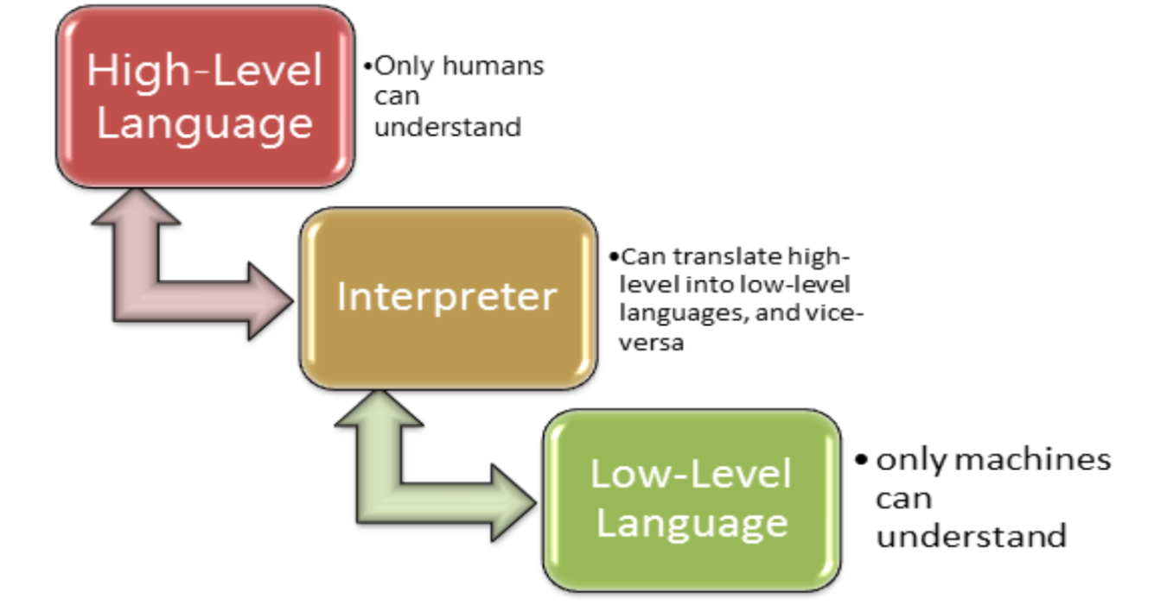

Slide 19
ASSEMBLY LANGUAGE
An assembly language, often abbreviated asm, is any low-level programming language, in which there is a very strong correspondence between the assembly program statements and the architecture's machine code instructions
An assembler is a program that takes basic computer instructions and converts them into a pattern of bits that the computer's processor can use to perform its basic operations. Some people call these instructions assembler language and others use the term assembly language.

Slide 20
Procedural vs Non Procedural
A procedural language is a computer programming language that follows, in order, a set of commands. Examples of computer procedural languages are BASIC, C, FORTRAN, Java, and Pascal. Procedural languages are some of the common types of programming languages used by script and software programmers.
In Non-procedural language, user instructs the system to produce the desired result without telling the step by step process. Here users tells what data to be retrieved from database but doesn't tell how to retrieve it.

Slide 21
Logic
Logic programming is a computer programming paradigm in which program statements express facts and rules about problems within a system of formal logic. Rules are written as logical clauses with a head and a body; for instance, "H is true if B1, B2, and B3 are true." Facts are expressed similar to rules, but without a body; for instance, "H is true."
Some logic programming languages such as Data log and Answer Set Programming (ASP) are purely declarative — they allow for statements about what the program should accomplish, with no explicit step-by-step instructions about how to do so. Others, such as Prolog, are a combination of declarative and imperative — they may also include procedural statements such as "To solve H, solve B1, B2, and B3.
• Think to solve
• Practice

Slide 22
Algorithms
Computing problems
Solved by executing a series of actions in a specific order
Algorithm a procedure determining
Actions to be executed
Order to be executed
Example: recipe
Program control
Specifies the order in which statements are executed

Slide 23
Pseudocode
Pseudocode
Artificial, informal language used to develop algorithms
Similar to everyday English
Not executed on computers
Used to think out program before coding
Easy to convert into C++ program
Only executable statements
No need to declare variables

Slide 24
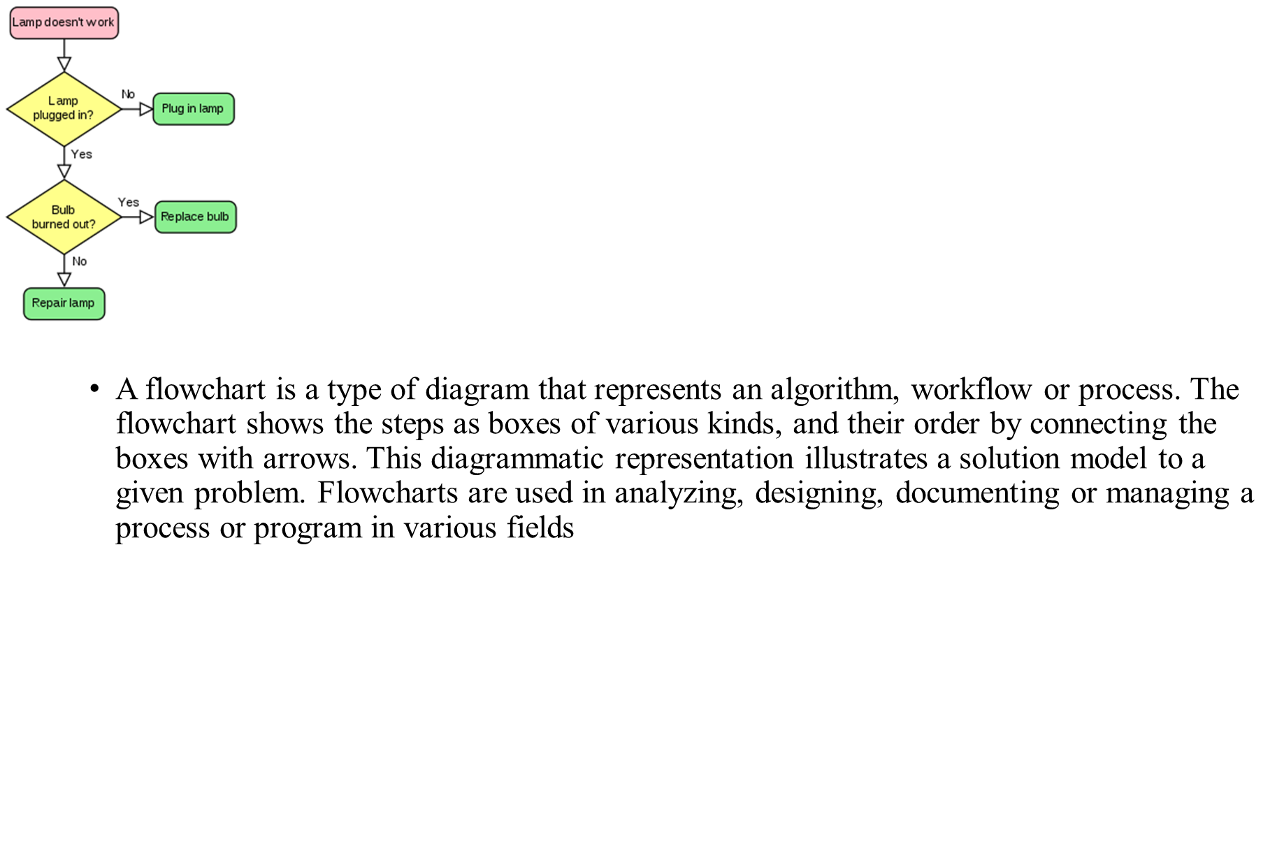
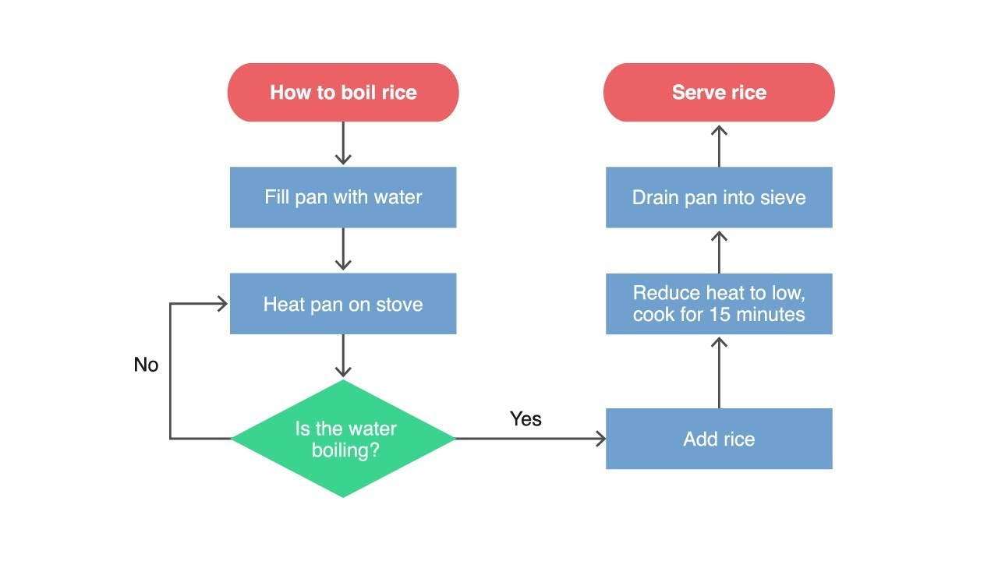
Flow Chart
A flowchart is a type of diagram that represents an algorithm, workflow or process. The flowchart shows the steps as boxes of various kinds, and their order by connecting the boxes with arrows. This diagrammatic representation illustrates a solution model to a given problem. Flowcharts are used in analyzing, designing, documenting or managing a process or program in various fields

Slide 25
Syntax
#include <iostream>
using namespace std;
int main()
{
cout << "Hello this is C++";
Return 0;
}

Slide 26
Data Types

Slide 27
What is an Identifier?
An identifier is the name to denote labels, types, variables, constants or functions, in a C++ program.
C++ is a case-sensitive language.
Work is not work
Identifiers should be descriptive
Using meaningful identifiers is a good programming practice

Slide 28
Identifier
Identifiers must be unique
Identifiers cannot be reserved words (keywords)
double main return
Identifier must start with a letter or underscore, and be followed by zero or more letters (A-Z, a-z), digits (0-9), or underscores
VALID
age_of_dog _taxRateY2K
PrintHeading ageOfHorse
NOT VALID
age# 2000TaxRate Age-Of-Dog main

Slide 29
C++ Data Types
simple
structured
integral enum
floating
array struct union class
char short int long bool
address
float double long double
pointer reference

Slide 30
C++ Primitive Data Types
Primitive types
integral
floating
char short int long bool float double long double
unsigned

Slide 31
Premitive Data Types in C++
Integral Types
represent whole numbers and their negatives
declared as int, short, or long
Character Types
represent single characters
declared as char
Stored by ASCII values
Boolean Type
declared as bool
has only 2 values true/false
will not print out directly
Floating Types
represent real numbers with a decimal point
declared as float, or double
Scientific notation where e (or E) stand for “times 10 to the ” (.55-e6)

Slide 32
Samples of C++ Data Values
int sample values
4578 -4578 0
bool values
true false
float sample values
95.274 95.0 .265
char sample values
‘B’ ‘d’ ‘4’ ‘?’ ‘*’

Slide 33
What is a Variable?
A variable is a memory address where data can be stored and changed.
Declaring a variable means specifying both its name and its data type.

Slide 34
What Does a Variable Declaration Do?
A declaration tells the compiler to allocate enough memory to hold a value of this data type, and to associate the identifier with this location.
int ageOfDog;→
char middleInitial; →
float taxRate;→

Slide 35
Variable Declaration
All variables must declared before use.
At the top of the program
Just before use.
Commas are used to separate identifiers of the same type.
int count, age;
Variables can be initialized to a starting value when they are declared
int count = 0;
int age, count = 0;

Slide 36
What is an Expression in C++?
An expression is a valid arrangement of variables, constants, and operators.
In C++, each expression can be evaluated to compute a value of a given type
In C++, an expression can be:
A variable or a constant (count, 100)
An operation (a + b, a * 2)
Function call (getRectangleArea(2, 4))

Slide 37
Assignment Operator
An operator to give (assign) a value to a variable.
Denote as ‘=‘
Only variable can be on the left side.
An expression is on the right side.
Variables keep their assigned values until changed by another assignment statement or by reading in a new value.

Slide 38
Assignment Operator Syntax
Variable = Expression
First, expression on right is evaluated.
Then the resulting value is stored in the memory location of Variable on left.
NOTE: An automatic type coercion occurs after evaluation but before the value is stored if the types differ for Expression and Variable

Slide 39
Assignment Operator Mechanism
Example:
int count = 0;
int starting;
starting = count + 5;
Expression evaluation:
Get value of count: 0
Add 5 to it.
Assign to starting
0
12345 (garbage)
5

Slide 40
Input and Output
C++ treats input and output as a stream of characters.
stream : sequence of characters (printable or nonprintable)
The functions to allow standard I/O are in iostream header file or iostream.h.
Thus, we start every program with
#include <iostream>
using namespace std;

Slide 41
Include Directives and Namespaces
include: directive copies that file into your program
namespace: a collection of names and their definitions. Allows different namespaces to use the same names without confusion

Slide 42
Keyboard and Screen I/O
#include <iostream>
input data
output data
executing
program
Keyboard
Screen
cin
(of type istream)
cout
(of type ostream)

Slide 43
Insertion Operator ( << )
Variable cout is predefined to denote an output stream that goes to the standard output device (display screen).
The insertion operator << called “put to” takes 2 operands.
The left operand is a stream expression, such as cout. The right operand is an expression of simple type or a string constant.

Slide 44
Output Statements
SYNTAX
cout statements can be linked together using << operator.
These examples yield the same output:
cout << “The answer is “ ;
cout << 3 * 4 ;
cout << “The answer is “ << 3 * 4 ;
cout << Expression << Expression . . . ;

Slide 45
Output Statements (String constant)
String constants (in double quotes) are to be printed as is, without the quotes.
cout<<“Enter the number of candy bars ”;
OUTPUT: Enter the number of candy bars
“Enter the number of candy bars ” is called a prompt.
All user inputs must be preceded by a prompt to tell the user what is expected.
You must insert spaces inside the quotes if you want them in the output.
Do not put a string in quotes on multiple lines.

Slide 46
Output Statements (Expression)
All expressions are computed and then outputted.
cout << “The answer is ” << 3 * 4 ;
OUTPUT: The answer is 12

Slide 47
Escape Sequences
The backslash is called the escape character.
It tells the compiler that the next character is “escaping” it’s typical definition and is using its secondary definition.
Examples:
new line: \n
horizontal tab: \t
backslash: \\
double quote \”

Slide 48
Newline
cout<<“\n” and cout<<endl both are used to insert a blank line.
Advances the cursor to the start of the next line rather than to the next space.
Always end the output of all programs with this statement.

Slide 49
Formatting for Decimal Point Numbers
Typed float, or double
Use the three format statements (magic formula) to format to fixed decimal notation.
cout.setf(ios::fixed);
cout.setf(ios::showpoint);
cout.precision(2);
setf “set flag” means that all real output will be formatted according to the function, until changed by either unsetting the flag or a new setf command.
ios:: means the functions from the iostream library

Slide 50
Extraction Operator (>>)
Variable cin is predefined to denote an input stream from the standard input device (the keyboard)
The extraction operator >> called “get from” takes 2 operands. The left operand is a stream expression, such as cin--the right operand is a variable of simple type.
Operator >> attempts to extract the next item from the input stream and store its value in the right operand variable.

Slide 51
Input Statements
SYNTAX
cin statements can be linked together using >> operator.
These examples yield the same output:
cin >> x;
cin >> y;
cin >> x >> y;
cin >> Variable >> Variable . . . ;

Slide 52
How Extraction Operator works?
Input is not entered until user presses <ENTER> key.
Allows backspacing to correct.
Skips whitespaces (space, tabs, etc.)
Multiple inputs are stored in the order entered:
cin>>num1>>num2;
User inputs: 3 4
Assigns num1 = 3 and num2 = 4

Slide 53
Numeric Input
Leading blanks for numbers are ignored.
If the type is double, it will convert integer to double.
Keeps reading until blank or <ENTER>.
Remember to prompt for inputs

Slide 54
C++ Data Type String
A string is a sequence of characters enclosed in double quotes
string sample values
“Hello” “Year 2000” “1234”
The empty string (null string) contains no displayed characters and is written as “”

Slide 55
C++ Data Type String (cont.)
string is not a built-in (standard) type
it is a programmer-defined data type
it is provided in the C++ standard library
Need to include the following two lines:
#include <string>
using namespace std;
string operations include
comparing 2 string values
searching a string for a particular character
joining one string to another (concatenation)
etc...

Slide 56
Type compatibilities
Warning: If you store values of one type in variable of another type the results can be inconsistent:
Can store integers in floating point or in char (assumes ASCII value)
bool can be stored as int: (true = nonzero, false = 0)
Implicit promotion: integers are promoted to doubles
double var = 2; // results in var = 2.0
On integer and doubles together:
Mixed type expressions: Both must be int to return int, otherwise float.

Slide 57
Type compatibilities (Implicit Conversion)
The compiler tries to be value-preserving.
General rule: promote up to the first type that can contain the value of the expression.
Note that representation doesn’t change but values can be altered .
Promotes to the smallest type that can hold both values.
If assign float to int will truncate
int_variable = 2.99; // results in 2 being stored in int_variable
If assign int to float will promote to double:
double dvar = 2; // results in 2.0 being stored in dvar

Slide 58
Type compatibilities (Explicit Conversion)
Casting - forcing conversion by putting (type) in front of variable or expression. Used to insure that result is of desired type.
Example: If you want to divide two integers and get a real result you must cast one to double so that a real divide occurs and store the result in a double.
int x=5, y=2; double z; z = static_cast <double>(x)/y; // 2.5
int x=5, y=2; double z; z = (double)x/y; // 2.5
int x=5, y=2; double z; z = static_cast <double>(x/y) ; // 2.0
converts x to double and then does mixed division, not integer divide
static_cast<int> (z) - will truncate z
static_cast <int> (x + 0.5) - will round positive x {use () to cast complete expression)
Cast division of integers to give real result:
int x=5, y=2; double z; z = static_cast <double>(x/y) ; // 2.0

Slide 59
Arithmetic Operators
Operators: +, -, * /
For floating numbers, the result as same as Math operations.
Note on integer division: the result is an integer. 7/2 is 3.
% (remainder or modulo) is the special operator just for integer. It yields an integer as the result. 7%2 is 1.
Both / and % can only be used for positive integers.
Precedence rule is similar to Math.

Slide 60
Arithmetic Expressions
Arithmetic operations can be used to express the mathematic expression in C++:

Slide 61
Simple Flow of Control
Three processes a computer can do:
Sequential
expressions, insertion and extraction operations
Selection (Branching)
if statement, switch statement
Repetition/Iteration (Loop)
while loop, do-while loop, for loop

Slide 62
bool Data Type
Type bool is a built-in type consisting of just 2 values, the constants true and false
We can declare variables of type bool
bool hasFever; // true if has high temperature
bool isSenior; // true if age is at least 55
The value 0 represents false
ANY non-zero value represents true

Slide 63
Boolean Expression
Expression that yields bool result
Include:
6 Relational Operators
< <= > >= == !=
3 Logical Operators
! && ||

Slide 64
Relational Operators
are used in boolean expressions of form:
ExpressionA Operator ExpressionB
temperature > humidity
B * B - 4.0 * A * C > 0.0
abs (number) == 35
initial != ‘Q’
Notes:
== (equivalency) is NOT = (assignment)
characters are compared alphabetically. However, lowercase letters are higher ASCII value.
An integer variable can be assigned the result of a logical expression
You cannot string inequalities together:
Bad Code: 4<x<6 Good Code: (x > 4) &&(x < 6)

Slide 65
Relational Operators
int x, y ;
x = 4;
y = 6;
EXPRESSION VALUE
x < y true
x + 2 < y false
x != y true
x + 3 >= y true
y == x false
y == x+2 true
y = x + 3 7
y = x < 3 0
y = x > 3 1

Slide 66
Logical Operators
are used in boolean expressions of form:
ExpressionA Operator ExpressionB
A || B (true if either A or B or both are true. It is false otherwise)
A && B (true if both A and B are true. It is false otherwise)
or
Operator Expression
!A (true if A is false. It is false if A is true)
Notes:
Highest precedence for NOT, AND and OR are low precedence.
Associate left to right with low precedence. Use parenthesis to override priority or for clarification
x && y || z will evaluate “x && y ” first
x && (y || z) will evaluate “y || z” first

Slide 67
Logical Operators
int age ;
bool isSenior, hasFever ;
float temperature ;
age = 20;
temperature = 102.0 ;
isSenior = (age >= 55) ; // isSenior is false
hasFever = (temperature > 98.6) ; // hasFever is true
EXPRESSION VALUE
isSenior && hasFever false
isSenior || hasFever true
!isSenior true
!hasFever false

Slide 68
Precedence Chart
++, --, !, - (unary minus), + (unary plus)
*, /, %
+ (addition), - (subtraction)
<<, >>
<, <=, >, >=
==, !=
&&
||
=
Highest
Lowest

Slide 69
Boolean Expression (examples)
taxRate is over 25% and income is less than $20000
temperature is less than or equal to 75 or humidity is less than 70%
age is between 21 and 60
age is 21 or 22

Slide 70
Boolean Expression (examples)
(taxRate > .25) && (income < 20000)
(temperature <= 75) || (humidity < .70)
(age >= 21) && (age <= 60)
(age == 21) || (age == 22)

Slide 71
Simple if Statement
Is a selection of whether or not to execute a statement or a block of statement.
TRUE
expression
statement(s)
FALSE

Slide 72
Simple if Statement Syntax
if (Boolean Expression)
Statement
if (Bool-Expr)
{
Statement_1
…
Statement_n
}

Slide 73
These are NOT equivalent. Why?
if (number == 0 )
{
cout << “Hmmmm ”;
cout << “You entered invalid number.\n”;
}
When number has value 0, the output will be:
Hmmmm You entered invalid number.
When number has value NOT 0, there is NO output.
if (number == 0 )
cout << “Hmmmm ”;
cout << “You entered invalid number.\n”;
When number has value 0, the output will be:
Hmmmm You entered invalid number.
When number has value NOT 0, the output will be:
You entered invalid number.

Slide 74
These are equivalent. Why?
if (number == 0 )
{
.
.
}
Read as:
If number is 0
if (!number )
{
.
.
}
Read as:
If number is NOT true
If number is false
Each expression is only true when number has value 0.

Slide 75
If-else Statement
provides selection between executing one of 2 clauses (the if clause or the else clause)
TRUE
FALSE
expression
if clause
else clause

Slide 76
Use of blocks
Denoted by { .. }
Recommended in controlled structures (if and loop)
Also called compound statement.
if (Bool-Expression )
{
}
else
{
}
“if clause”
“else clause”

Slide 77
Loop
is a repetition control structure.
causes a single statement or block of statements to be executed repeatedly until a condition is met.
There are 3 kinds of loop in C++:
While loop
Do-While loop
For loop

Slide 78
While Loop
SYNTAX
while ( Expression )
{
… // loop body
}
No semicolon after the boolean expression
Loop body can be a single statement, a null statement, or a block.

Slide 79
While Loop Mechanism
When the expression is tested and found to be false, the loop is exited and control passes to the statement which follows the loop body.
When the expression is tested and found to be true, the loop body is executed. Then, the expression is tested again.
FALSE
Expression
TRUE
body
statement

Slide 80
While Loop Example
int count ;
count = 0; // initialize LCV
while (count < 5) // test expression
{
cout << count << “ ”; // repeated action
count = count + 1; // update LCV
}
cout << “Done” << endl ;

Slide 81
Loop Tracing
int count ;
count = 0;
while (count < 5)
{
cout << count << “ ”;
count = count + 1;
}
cout << “Done” << endl ;
count Expression Output
0 true 0
1 true 0 1
2 true 0 1 2
3 true 0 1 2 3
4 true 0 1 2 3 4
5 false 0 1 2 3 4 Done

Slide 82
Increment and Decrement Operators
Denoted as ++ or --
Mean increase or decrease by 1
Pre increment/decrement: ++a, --a
Increase/decrease by 1 before use.
Post increment/decrement: a++, a--
Increase/decrease by 1 after use.
Pre and Post increment/decrement yield different results when combining with another operation.

Slide 83
Pre and Post Increment and Decrement
count Expression Output
int count ;
count = 0;
while (count < 5)
{
cout << count++ << “ “ ;
}
cout << “Done” << endl ;
0 true 0
1 true 0 1
2 true 0 1 2
3 true 0 1 2 3
4 true 0 1 2 3 4
5 false 0 1 2 3 4 Done
int count ;
count = 0;
while (count < 5)
{
cout << ++count << “ “ ;
}
cout << “Done” << endl ;
count Expression Output
0 true 1
1 true 1 2
2 true 1 2 3
3 true 1 2 3 4
4 true 1 2 3 4 5
5 false 1 2 3 4 5 Done

Slide 84
Do-While Loop
SYNTAX
do
{
… // loop body
} while ( Expression );
Insured that the loop is executed at least once
The LCV is initialized/updated before the end of the loop.
Boolean expression is tested at the end of the loop.
There is a semicolon after the boolean expression.

Slide 85
Do-While Loop Mechanism
The loop body is executed first
When the expression is tested and found to be false, the loop is exited and control passes to the statement which follows the loop body.
When the expression is tested and found to be true, the loop body is executed. Then, the expression is tested again.
body
statement
FALSE
TRUE
Expression

Slide 86
Do-While Loop Example
int ans;
do
{
cout << “Choose a number from 1 to 4: “;// repeated action
cin >> ans; // LCV is initialized or updated
} while (ans >= 1 && ans <= 4); // test expression
cout << “Done”;
Output Input ans Expression
Choose a number from 1 to 4: 2 2 true
Choose a number from 1 to 4: 3 3 true
Choose a number from 1 to 4: 1 1 true
Choose a number from 1 to 4: 5 5 false
Done

Slide 87
Loop-Controlled Types
Count-controlled: repeat a specified number of times.
Event-driven: some condition within the loop body changes and this causes the repeating to stop.
Sentinel-controlled: using a specific value to end.
Sentinel: a value that cannot occur as valid data.
Ask-before-Continuing: ask users if they want to continue.
Flag-Controlled Loops: use a variable whose value is changed when an event occurs (usually from false to true).

Slide 88
Count-Controlled Loop
Has a loop control variable (LCV) as a counter.
LCV must be
Initialized before start of the loop
Tested (boolean expression)
Updated

Slide 89
Event-driven loop
double salary;
cout << "Enter you salary: ";
cin >> salary;
int years = 0;
while (salary < 50000) {
salary = salary * 1.02;
years++;
}
cout << “You need “ << years << “years to get to 50K";

Slide 90
Sentinel-Controlled
do
{
cout<< ”Enter salary, type -1 to exit”; // no one earns negative salary
cin>>salary;
// process income
} while (salary > 0);

Slide 91
Ask-before-Continuing
char ans = ‘y’; // LCV is initialized
while (ans == ‘Y’ || ans == ‘y’) // test expression
{
doSomething; // repeated action
cout << “Do you want to continue? ”;
cin >> ans; // LCV is updated
};

Slide 92
BREAK statement
allows to exit from any loop.
do
{
cin>>x;
if (x % 2 ==0)
break;
} while (x > 0); // exits when an even number is entered

Slide 93
CONTINUE Statement
allows you to skip the rest of the loop body and go back to the beginning of the loop.
do
{
cin>>x;
if (x % 2 == 0)
continue;
cout<<x<<endl;
} while (x <100);
//prints out all odd numbers entered less than 100

Slide 94
Program Style
Indenting:
Separate processes with blank lines
Blank lines are also ignored and are used to increase readability.
indent statements within statements (loop body)
Comments:
// tells the computer to ignore this line.
for internal documentation. This is done for program clarity and to facilitate program maintenance.

Slide 95
General rules for Comments
Place a comment at the beginning of every file with the file name, version number, a brief program description, programmer’s name.
Place a descriptive comment after each variable declared.
Use a blank line before and after variable declarations
Place a descriptive comment and a blank line before each subtask.

Slide 96
Constants
Syntax: const type identifier = value;
Ex: const double TAX_RATE = 0.08;
Convention: use upper case for constant ID.

Slide 97
Why use constants?
Clarity: Tells the user the significance of the number. There may be the number 0.08 elsewhere in the program, but you know that it doesn’t stand for TAXRATE.
Maintainability. Allows the program to be modified easily.
Ex: Program tax compute has const double TAXRATE=0.0725. If taxes rise to 8%, programmer only has to change the one line to const double TAXRATE=0.08
Safety: Cannot be altered during program execution

Slide 98
Control Structures
Sequential execution
Statements executed in order
Transfer of control
Next statement executed not next one in sequence
Structured programming – “goto”-less programming
3 control structures to build any program
Sequence structure
Programs executed sequentially by default
Selection structures
if, if/else, switch
Repetition structures
while, do/while, for

Slide 99
Control Structures
Flowchart
Graphical representation of an algorithm
Special-purpose symbols connected by arrows (flowlines)
Rectangle symbol (action symbol)
Any type of action
Oval symbol
Beginning or end of a program, or a section of code (circles)
Single-entry/single-exit control structures
Connect exit point of one to entry point of the next
Control structure stacking

Slide 100
if Selection Structure
Selection structure
Choose among alternative courses of action
Pseudocode example:
If student’s grade is greater than or equal to 60
Print “Passed”
If the condition is true
Print statement executed, program continues to next statement
If the condition is false
Print statement ignored, program continues
Indenting makes programs easier to read
C++ ignores whitespace characters (tabs, spaces, etc.)

Slide 101
if Selection Structure
Translation into C++
If student’s grade is greater than or equal to 60
Print “Passed”
if ( grade >= 60 ) cout << "Passed";
Diamond symbol (decision symbol)
Indicates decision is to be made
Contains an expression that can be true or false
Test condition, follow path
if structure
Single-entry/single-exit

Slide 102
if Selection Structure
Flowchart of pseudocode statement
A decision can be made on any expression.
zero - false
nonzero - true
Example:
3 - 4 is true
true
grade >= 60
print “Passed”
false

Slide 103
if/else Selection Structure
if
Performs action if condition true
if/else
Different actions if conditions true or false
Pseudocode
if student’s grade is greater than or equal to 60 print “Passed”
else
print “Failed”
C++ code
if ( grade >= 60 ) cout << "Passed"; else cout << "Failed";

Slide 104
if/else Selection Structure
Ternary conditional operator (?:)
Three arguments (condition, value if true, value if false)
Code could be written:
cout << ( grade >= 60 ? “Passed” : “Failed” );
Condition
Value if true
Value if false
false
true
grade >= 60
print “Failed”
print “Passed”

Slide 105
if/else Selection Structure
Nested if/else structures
One inside another, test for multiple cases
Once condition met, other statements skipped
if student’s grade is greater than or equal to 90 Print “A”
else if student’s grade is greater than or equal to 80 Print “B” else if student’s grade is greater than or equal to 70 Print “C” else if student’s grade is greater than or equal to 60 Print “D” else
Print “F”

Slide 106
if/else Selection Structure
Example
if ( grade >= 90 ) // 90 and above cout << "A"; else if ( grade >= 80 ) // 80-89 cout << "B"; else if ( grade >= 70 ) // 70-79 cout << "C"; else if ( grade >= 60 ) // 60-69 cout << "D"; else // less than 60 cout << "F";

Slide 107
if/else Selection Structure
Compound statement
Set of statements within a pair of braces
if ( grade >= 60 ) cout << "Passed.\n"; else { cout << "Failed.\n"; cout << "You must take this course again.\n"; }
Without braces,
cout << "You must take this course again.\n";
always executed
Block
Set of statements within braces

Slide 108
while Repetition Structure
Repetition structure
Action repeated while some condition remains true
Psuedocode
while there are more items on my shopping list
Purchase next item and cross it off my list
while loop repeated until condition becomes false
Example
int product = 2;
while ( product <= 1000 )
product = 2 * product;

Slide 109
while Repetition Structure
Flowchart of while loop
true
product <= 1000
product = 2 * product
false

Slide 110
Counter-Controlled Repetition
Counter-controlled repetition
Loop repeated until counter reaches certain value
Definite repetition
Number of repetitions known
Example
A class of ten students took a quiz. The grades (integers in the range 0 to 100) for this quiz are available to you. Determine the class average on the quiz.

Slide 111
Sentinel-Controlled Repetition
Suppose problem becomes:
Develop a class-averaging program that will process an arbitrary number of grades each time the program is run
Unknown number of students
How will program know when to end?
Sentinel value
Indicates “end of data entry”
Loop ends when sentinel input
Sentinel chosen so it cannot be confused with regular input
-1 in this case

Slide 112
switch Multiple-Selection Structure
switch
Test variable for multiple values
Series of case labels and optional default case
switch ( variable ) { case value1: // taken if variable == value1
statements
break; // necessary to exit switch
case value2:
case value3: // taken if variable == value2 or == value3
statements
break;
default: // taken if none matches
statements break;
}

Slide 113
switch Multiple-Selection Structure
true
case a
case a action(s)
break
false
case b
true
case b action(s)
break
false
.
.
.
case z
true
case z action(s)
break
false
default action(s)

Slide 114
switch Multiple-Selection Structure
Example upcoming
Program to read grades (A-F)
Display number of each grade entered
Details about characters
Single characters typically stored in a char data type
char a 1-byte integer, so chars can be stored as ints
Can treat character as int or char
97 is the numerical representation of lowercase ‘a’ (ASCII)
Use single quotes to get numerical representation of character
cout << "The character (" << 'a' << ") has the value " << static_cast< int > ( 'a' ) << endl;
Prints
The character (a) has the value 97

Slide 115
do/while Repetition Structure
Similar to while structure
Makes loop continuation test at end, not beginning
Loop body executes at least once
Format
do {
statement
} while ( condition );
action(s)
true
condition
false

Slide 116
break and continue Statements
break statement
Immediate exit from while, for, do/while, switch
Program continues with first statement after structure
Common uses
Escape early from a loop
Skip the remainder of switch

Slide 117
Logical Operators
Used as conditions in loops, if statements
&& (logical AND)
true if both conditions are true
if ( gender == 1 && age >= 65 ) ++seniorFemales;
|| (logical OR)
true if either of condition is true
if ( semesterAverage >= 90 || finalExam >= 90 ) cout << "Student grade is A" << endl;

Slide 118
Logical Operators
! (logical NOT, logical negation)
Returns true when its condition is false, & vice versa
if ( !( grade == sentinelValue ) ) cout << "The next grade is " << grade << endl;
Alternative:
if ( grade != sentinelValue ) cout << "The next grade is " << grade << endl;

Slide 119
Confusing Equality (==) and Assignment (=) Operators
Common error
Does not typically cause syntax errors
Aspects of problem
Expressions that have a value can be used for decision
Zero = false, nonzero = true
Assignment statements produce a value (the value to be assigned)

Slide 120
Confusing Equality (==) and Assignment (=) Operators
Example
if ( payCode == 4 )
cout << "You get a bonus!" << endl;
If paycode is 4, bonus given
If == was replaced with =
if ( payCode = 4 ) cout << "You get a bonus!" << endl;
Paycode set to 4 (no matter what it was before)
Statement is true (since 4 is non-zero)
Bonus given in every case

Slide 121
Confusing Equality (==) and Assignment (=) Operators
Lvalues
Expressions that can appear on left side of equation
Can be changed (I.e., variables)
x = 4;
Rvalues
Only appear on right side of equation
Constants, such as numbers (i.e. cannot write 4 = x;)
Lvalues can be used as rvalues, but not vice versa

Slide 122
Structured-Programming Summary
Structured programming
Programs easier to understand, test, debug and modify
Rules for structured programming
Only use single-entry/single-exit control structures
Rules
1) Begin with the “simplest flowchart”
2) Any rectangle (action) can be replaced by two rectangles (actions) in sequence
3) Any rectangle (action) can be replaced by any control structure (sequence, if, if/else, switch, while, do/while or for)
4) Rules 2 and 3 can be applied in any order and multiple times

Slide 123
Structured-Programming Summary
Representation of Rule 3 (replacing any rectangle with a control structure)
Rule 3
Rule 3
Rule 3

Slide 124
Structured-Programming Summary
All programs broken down into
Sequence
Selection
if, if/else, or switch
Any selection can be rewritten as an if statement
Repetition
while, do/while or for
Any repetition structure can be rewritten as a while statement

